Slide 1



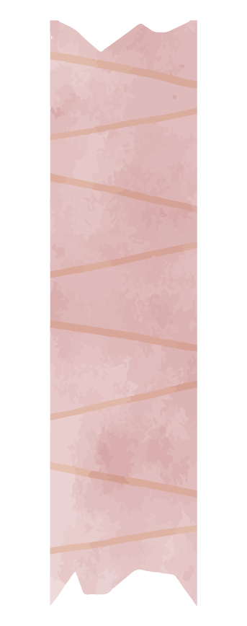
AP Psychology
Does surrounding beauty have an effect on test performance?

Slide 2
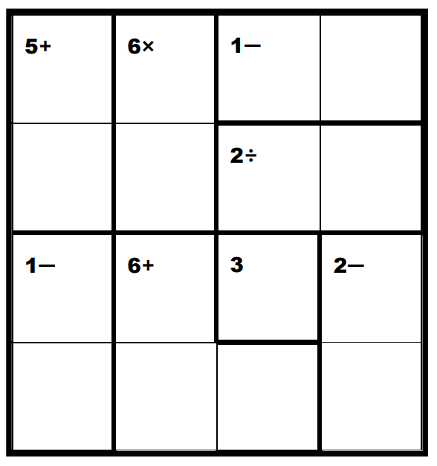
Parameters
Independent variable: surrounding beauty
I identified four components of beauty (more on next slide)
Decorations and organization of objects would act as treatments
Dependent variable: test performance
To measure, I used a KenKen puzzle
Independent from prior knowledge or classes
Relatively unknown
Varies based on external conditions
2 groups: 16 participants each
Across all grades, if possible (not recorded)
Convenience samples from lower cafe

Slide 3


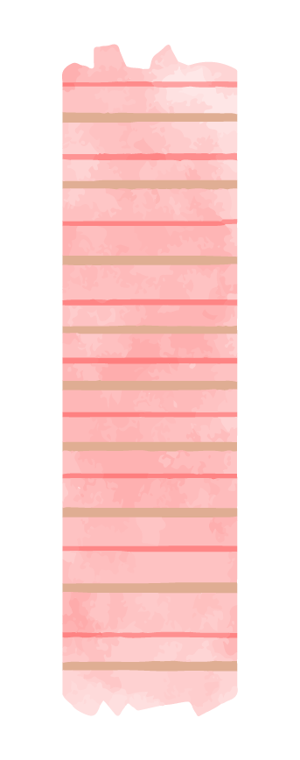
Components
of Beauty
Life
Art
Color
Order
free beauty:
not influenced by conceptions of its purpose
dependent beauty: influenced by conceptions of its purpose
strong historical associations with beauty
strong historical associations with beauty

Slide 4

Hypothesis:
if a student’s surroundings include elements of beauty, then they would perform better on an academic test.

Slide 5

Experimental Design

Slide 6
Room 119
Conference room
Blank, able to decorate
Low levels of noise and outside distractions
No prior mental associations

Slide 7
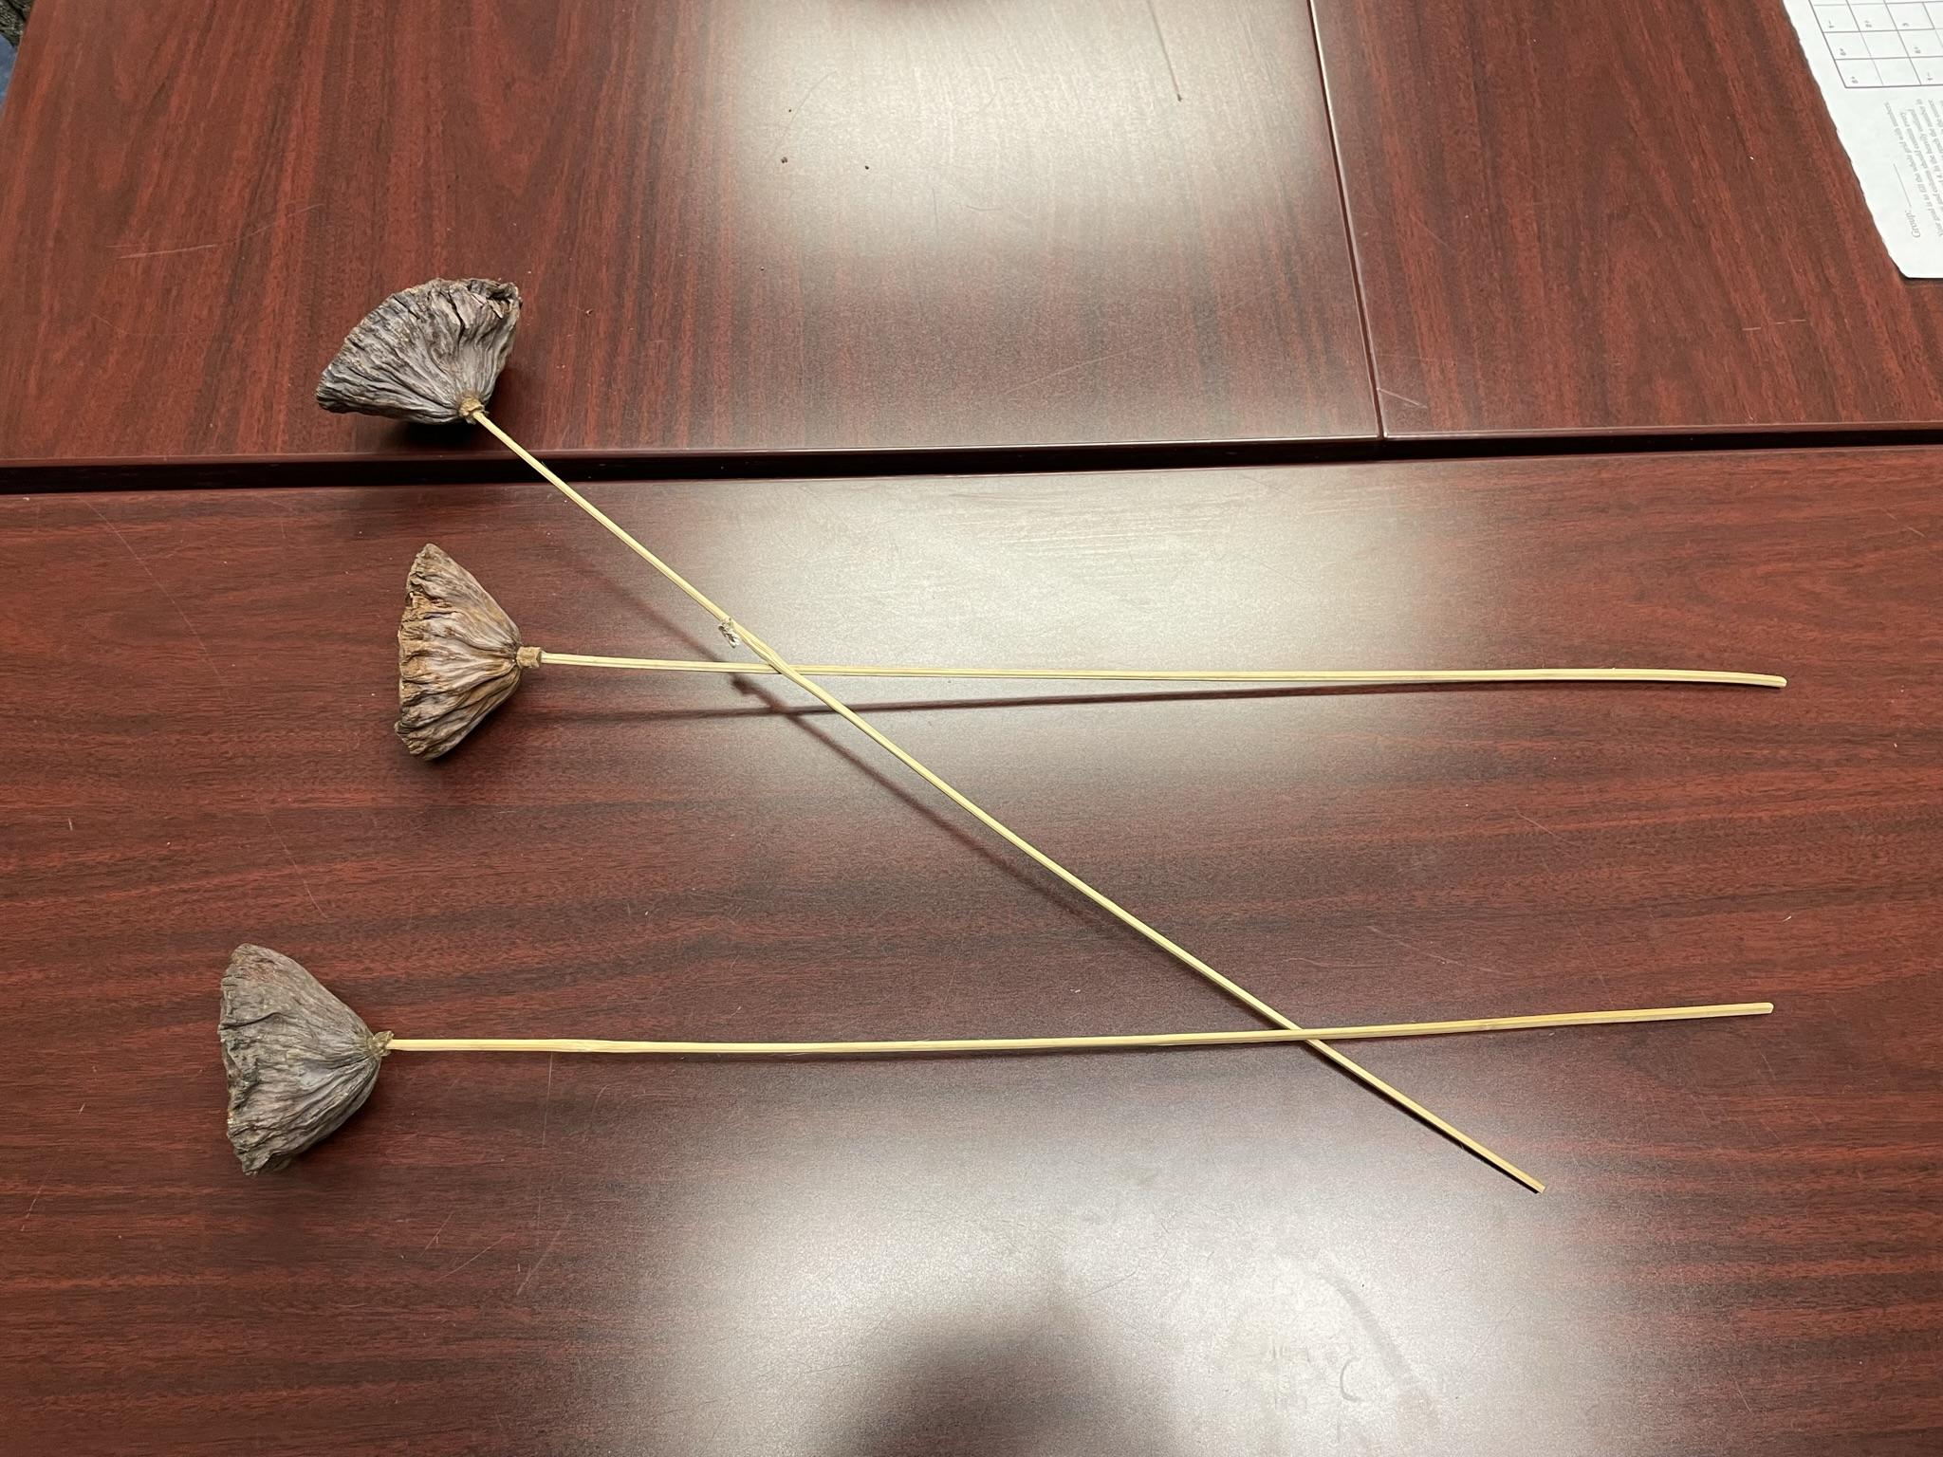
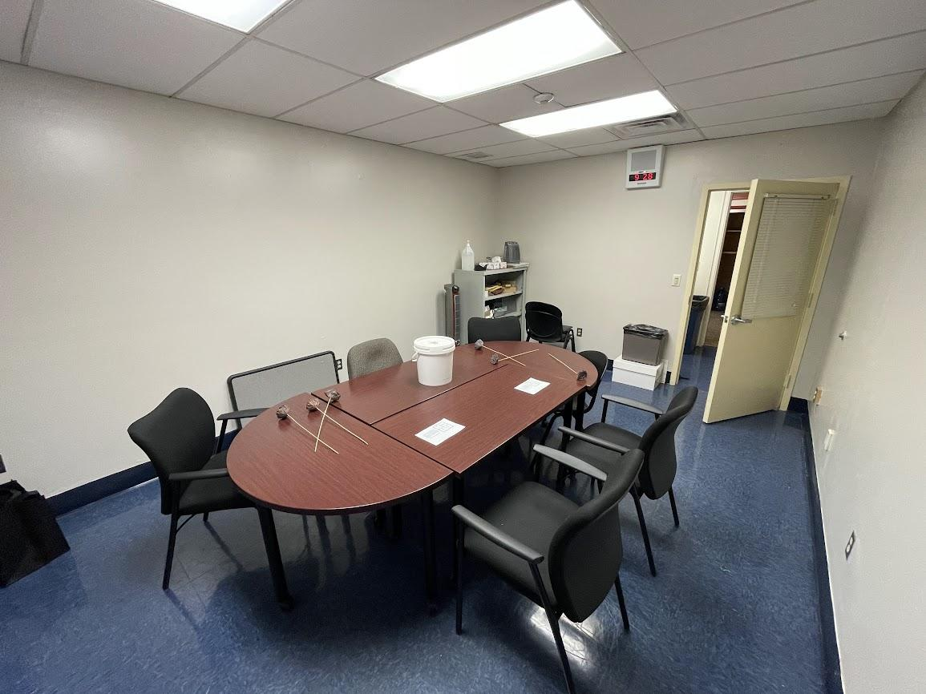
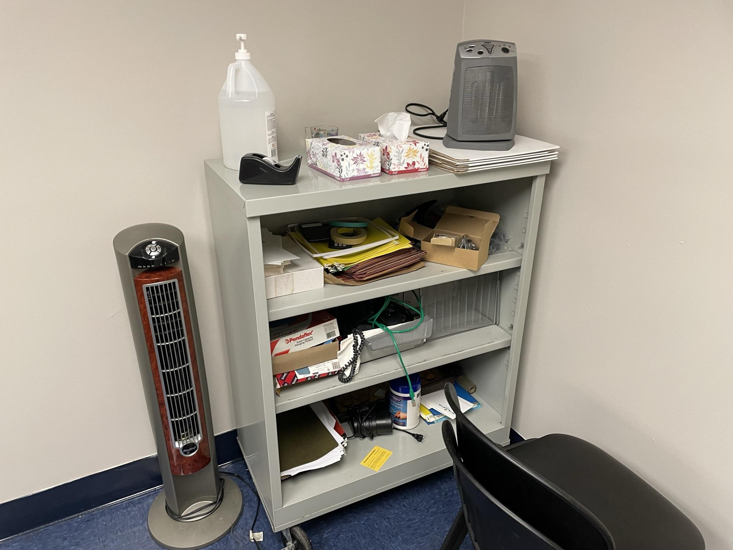
The “ugly room”

Slide 8
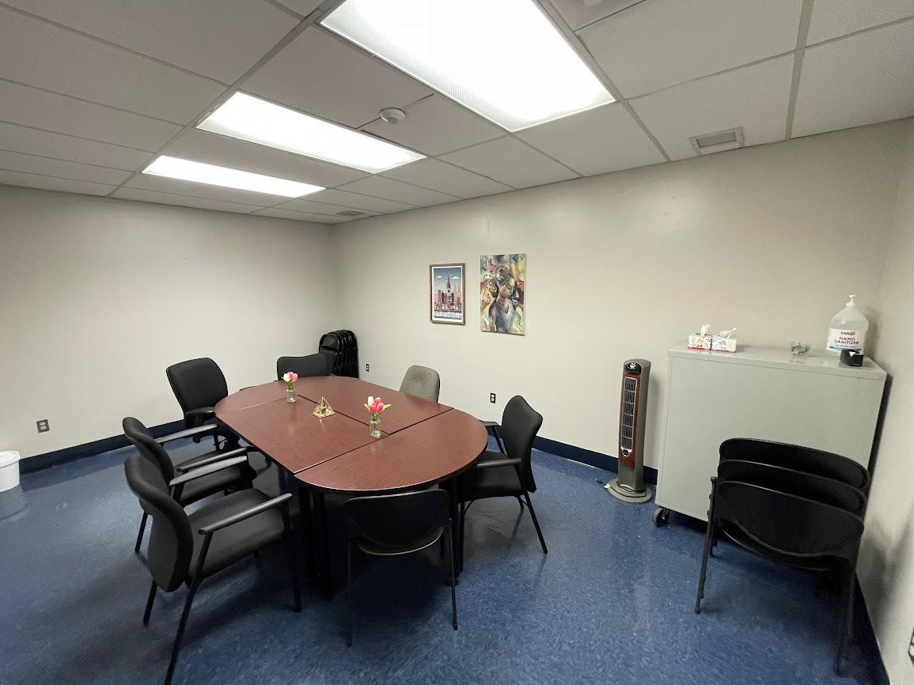

The “beautiful room”

Slide 9
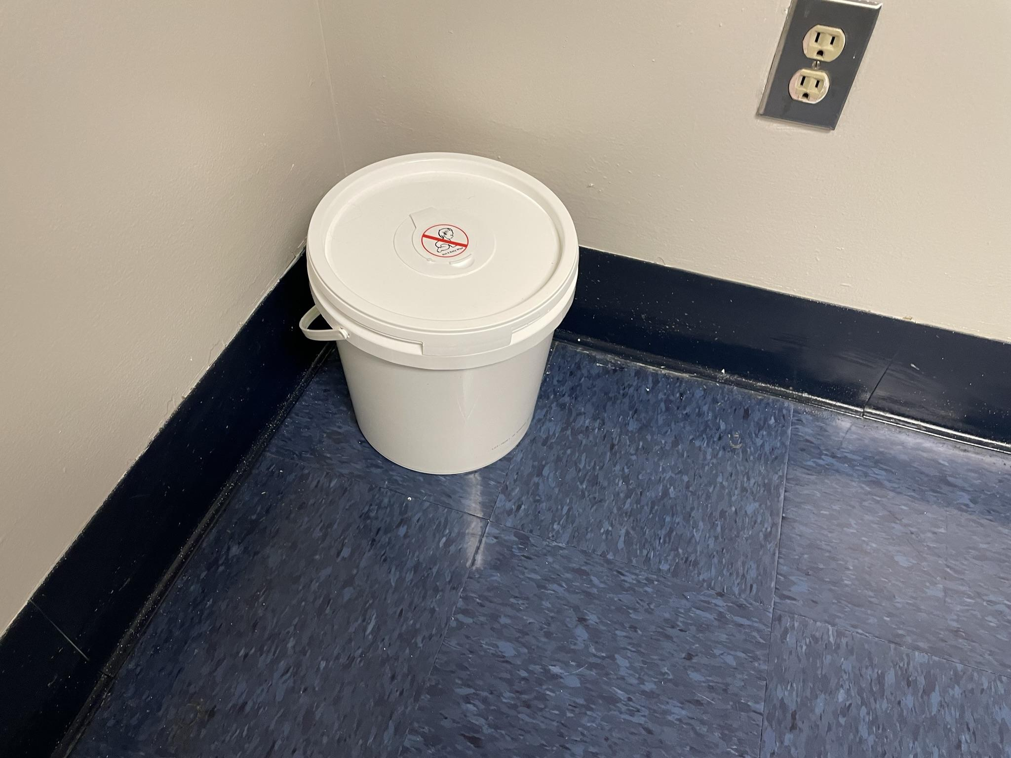
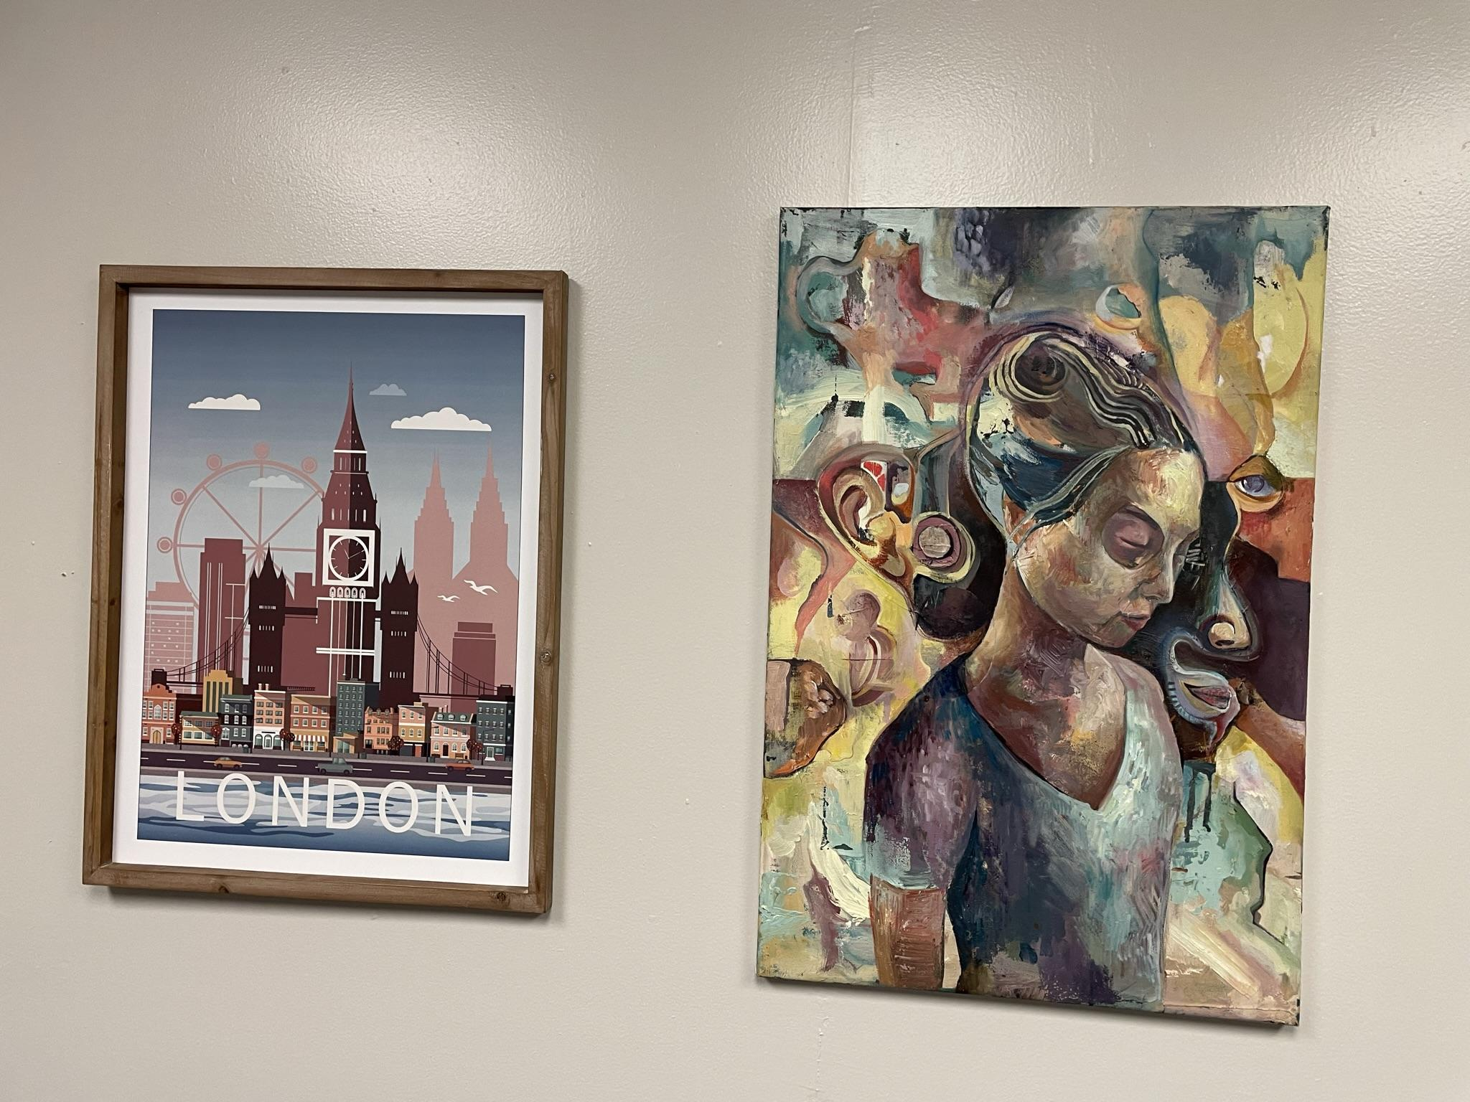
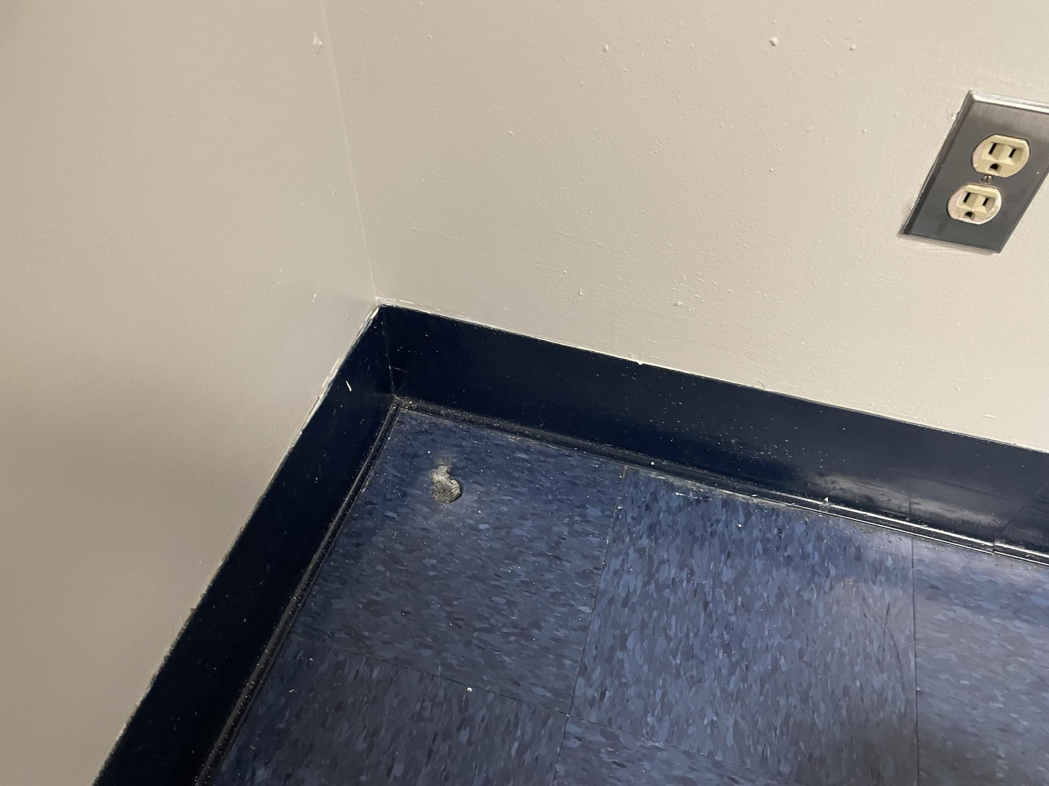
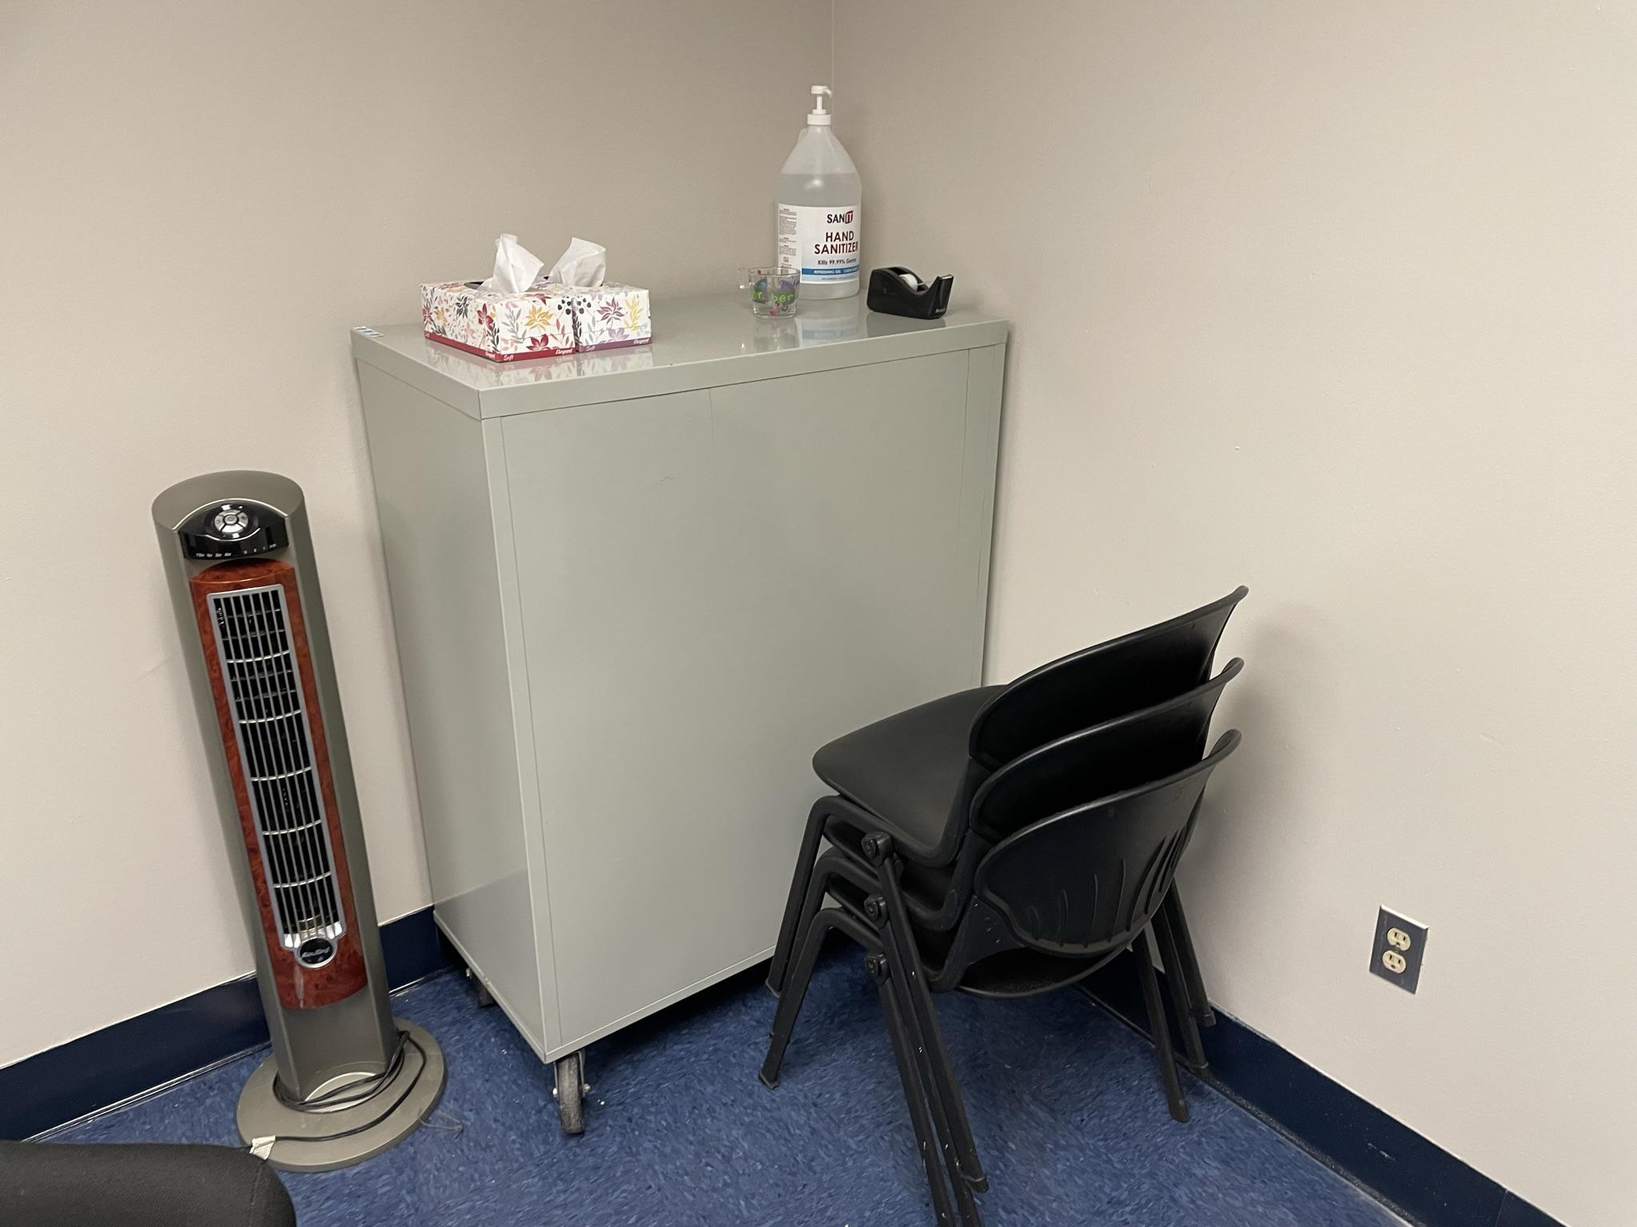
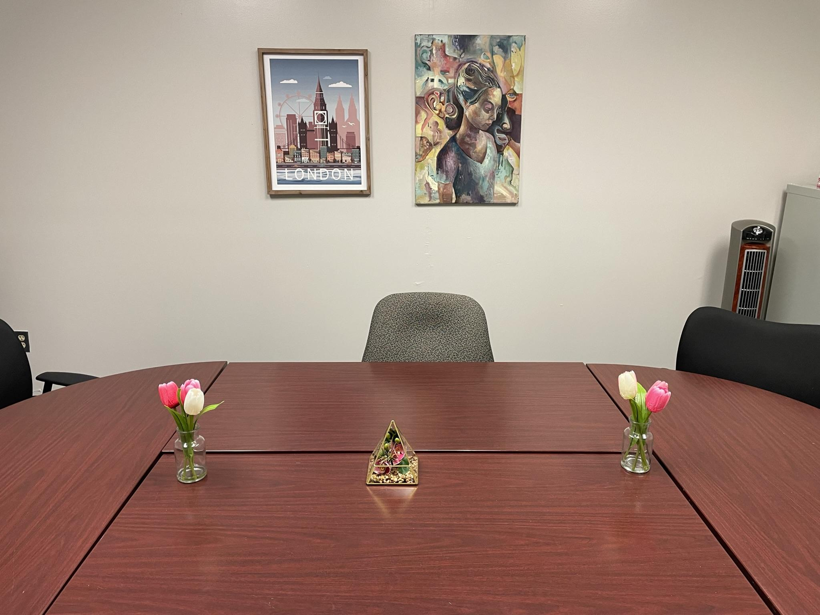
The “beautiful room”

Slide 10
Procedure
In pairs for expediency; no names were collected
First asked if they had any prior knowledge of the puzzle in front of them, which was called a KenKen puzzle.
One participant from each group had recognized the type of puzzle, but neither had any prior knowledge as to how it was completed.
Given a brief verbal description of the rules of the puzzle, and an opportunity to ask questions.
All instructions were also listed on the puzzle sheet.
Informed that they had five minutes to complete the puzzle, and directed to note the analog clock to their right.
All participants received the same puzzle.

Slide 11
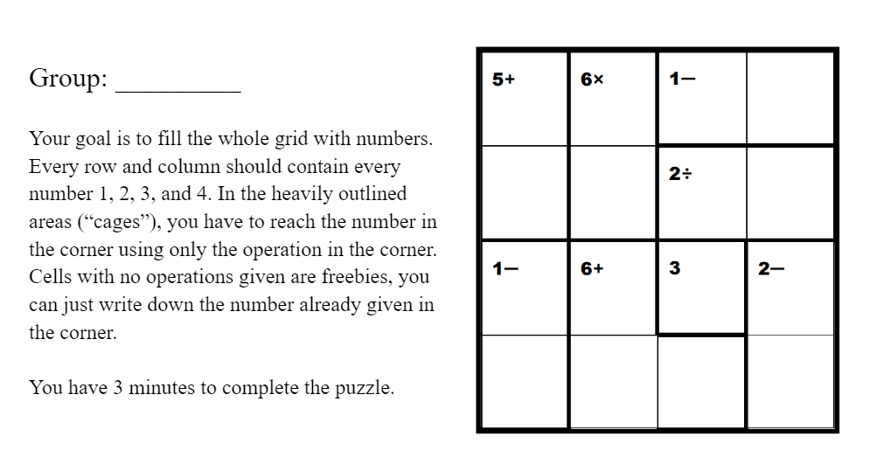
KenKen puzzle sheet given to participants.
The “3” in the last sentence was crossed out to write “5”.

Slide 12
Procedure (cont.)
Puzzles were collected, given a second sheet of paper to report the beauty of the room on a seven-point scale.
Intended to verify that participants indeed viewed the “beautiful room” as being more beautiful than the “ugly room”
Beauty score sheets were collected, participants were debriefed on the purpose of the experiment and given an opportunity to ask questions.
Instructed to not share information regarding the objective of the experiment
They could report to peers that they had to “complete a logic puzzle”

Slide 13
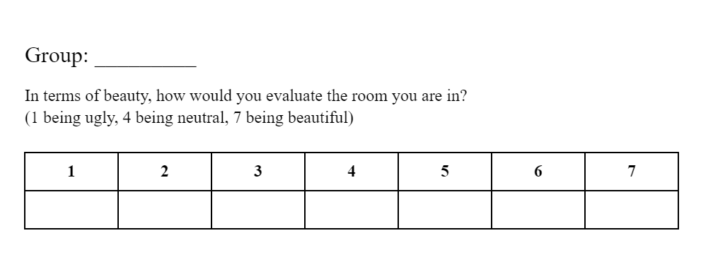
Beauty score sheet given to participants

Slide 14
Results

Slide 15
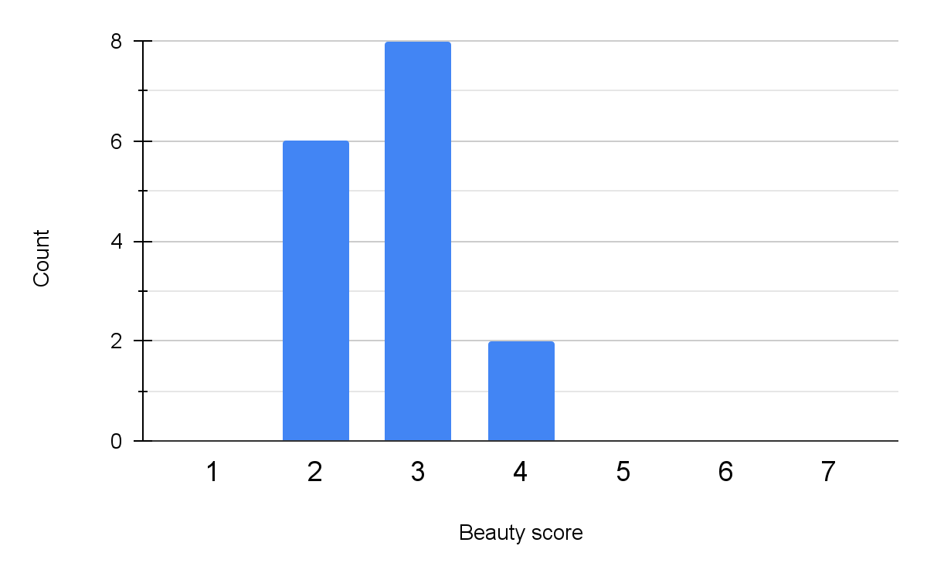
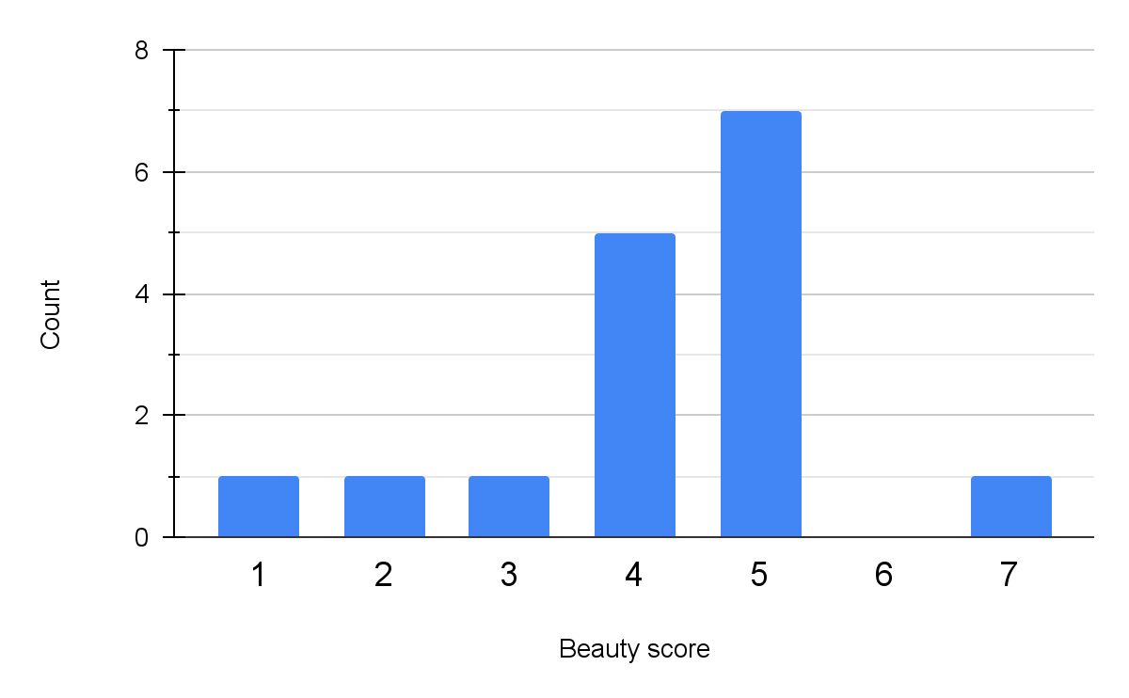
p<0.001
Distribution of beauty scores for the “ugly room”
Average = 2.75
Distribution of beauty scores for the “beautiful room”
Average = 4.25

Slide 16
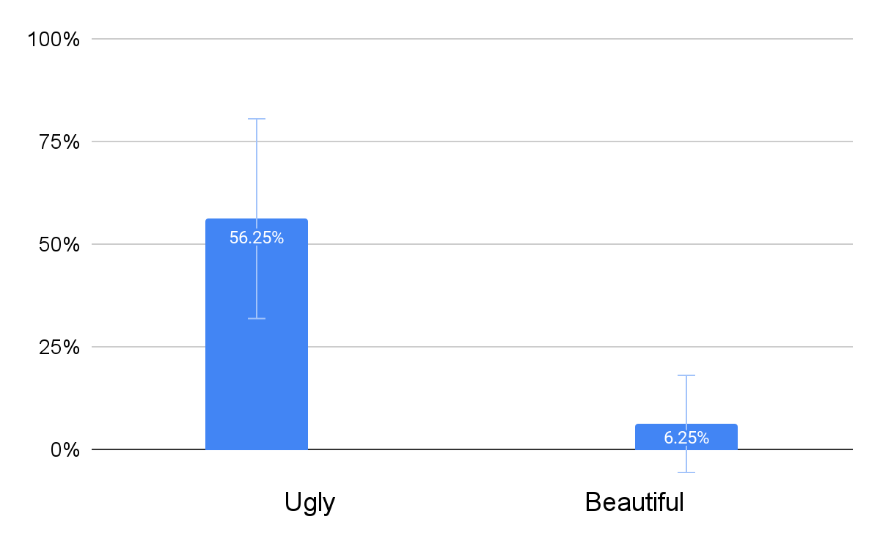
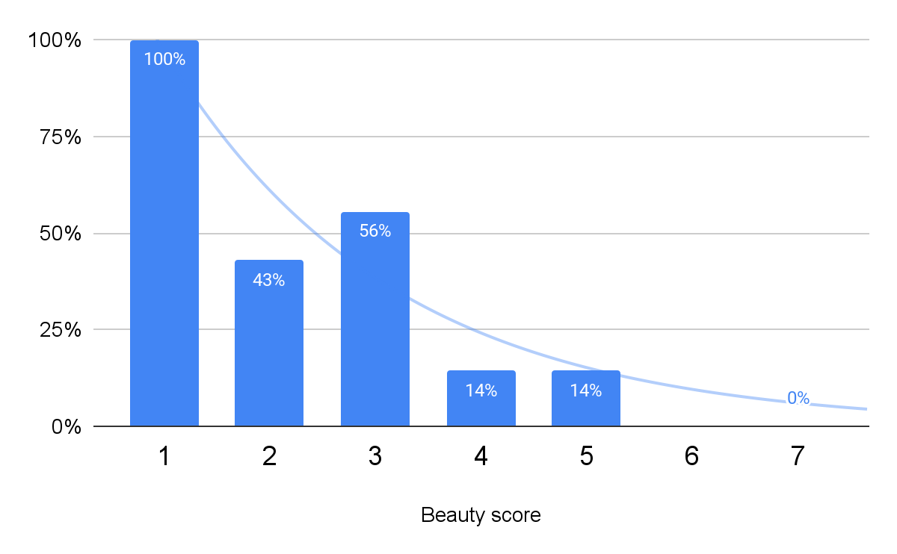
p=0.002
Proportion of puzzles correctly completed
in each room
Bars depict 95% confidence intervals
Proportion of puzzles correctly completed for each beauty score
y = -0.971e^{-0.464x}
R² = 0.892

Slide 17
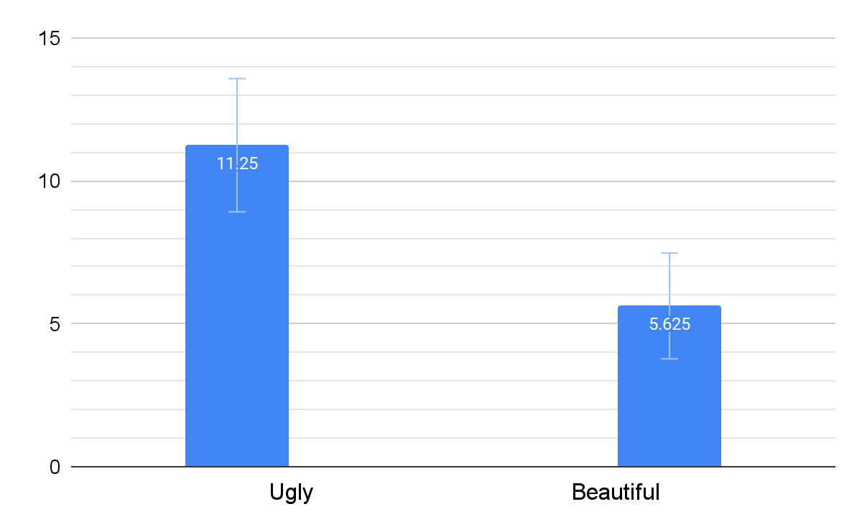
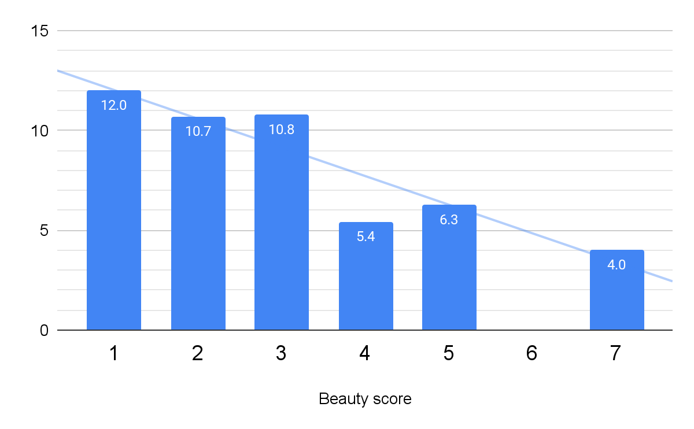
p=0.002
Mean number of cells correct in each room, out of 15 possible cells
Bars depict 95% confidence intervals
Mean cells correct for each beauty score, out of 15 possible cells
y = -1.44x + 12
R² = 0.854

Slide 18
Conclusion

Slide 19
Confounding variables?
Different times
Beauty scores impacted by performance
IB French
Ugly room:
Periods 2–4, Tuesday, May 17
Beautiful room: Periods 4 & 5, Thursday, May 19
An IB French test was occurring in a nearby room during the latter portion of the collection for the beautiful room.
May have impacted comfort or focus
Because evaluation of beauty happened afterwards
Hypothesized confounding impact was not observed
Not a confounding variable for relationship between rooms

Slide 20
The experiment provided convincing evidence that the inclusion of elements of beauty in one’s surroundings hinders test performance.

Slide 21


Thank you!

